Slide 1
LESSON ELEVEN
TOPICS: HOW TO IMPLEMENT A GAME TIMER.

Slide 2
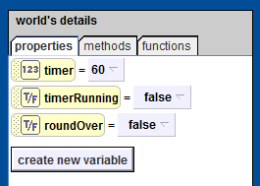
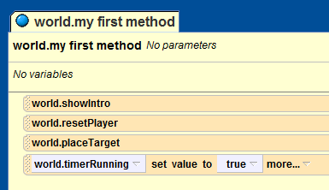
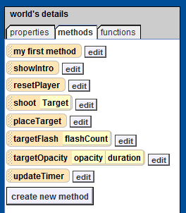
Step 1: Create the Timer Variables and Methods
Add three variables to the world object:
the number variable “timer”
The Boolean variable “timerRunning”
The Boolean variable “roundOver”
Add the line
To the end of the “world.my first method” method
Create a new method called “updateTimer”

Slide 3
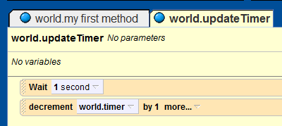
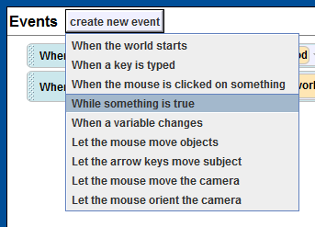
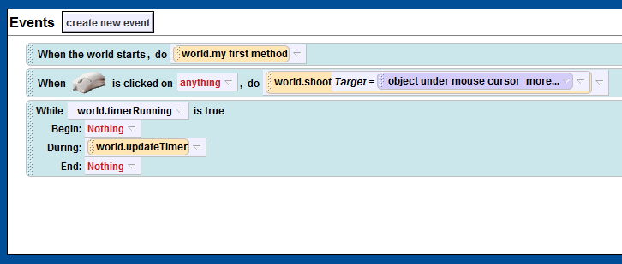
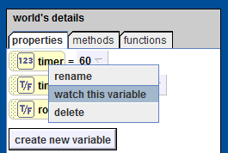
Step 2: Adding Functionality to the Timer
In the “updateTimer” method, add a “wait” command with duration of 1 second.
Create a new “while something is true” event.
For the new “while something is true event,” set the <None> field to the “world.timerRuning” variable, and set the “During” filed to the method “world.updateTimer.
Right click on the “timer” variable and select “watch this variable”.
Now play your world and observe what happens to the value of the timer variable.
Notes:
QUESTION: What happens to “timer” if we just let the game continue to run?
ANSWER: The value of “timer” becomes negative.
QUESTION: Is this good or bad? Why?
ANSWER: Bad. For a game, it is more of an aesthetic thing than a programing problem: it looks better if the game stops at zero than continues to count down after the time is up.
QUESTION: How can we fix this problem?
ANSWER: Add a conditional to the updateTimer method.

Slide 4
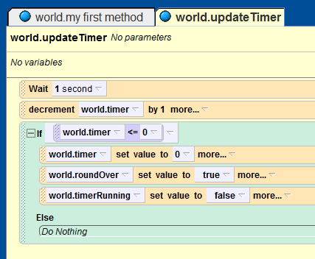
Step 3: Ending the Game When the Time Runs Out
Add an “if” statement to the “world.updateTimer” method.
Drag the “world.timer” variable over the conditional for your new if statement. In the pop-up menu, select world.time <=, and then type “0”.
Drag the “world.timer” variable inside the if-statement and set its value to 0.
Drag the “world.roundOver” variable inside the if-statement and set its value to “true”.
Drage the “world.timerRunning” variable inside the if-statement and set its value to “false”

Slide 5
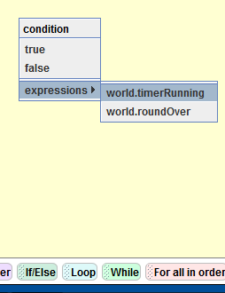
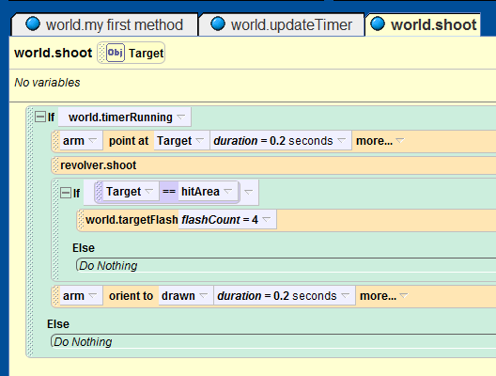
Step 4: Preventing the Player from Shooting After Time Runs Out
Open up the “world.shoot” method in the code editor.
Add a new if-statement to the “world.shoot” method. For the condition, select the “world.timerRunning” variable. Drag all of the previous lines of code from the “world.shoot” method inside of the new if-statement.

Slide 6
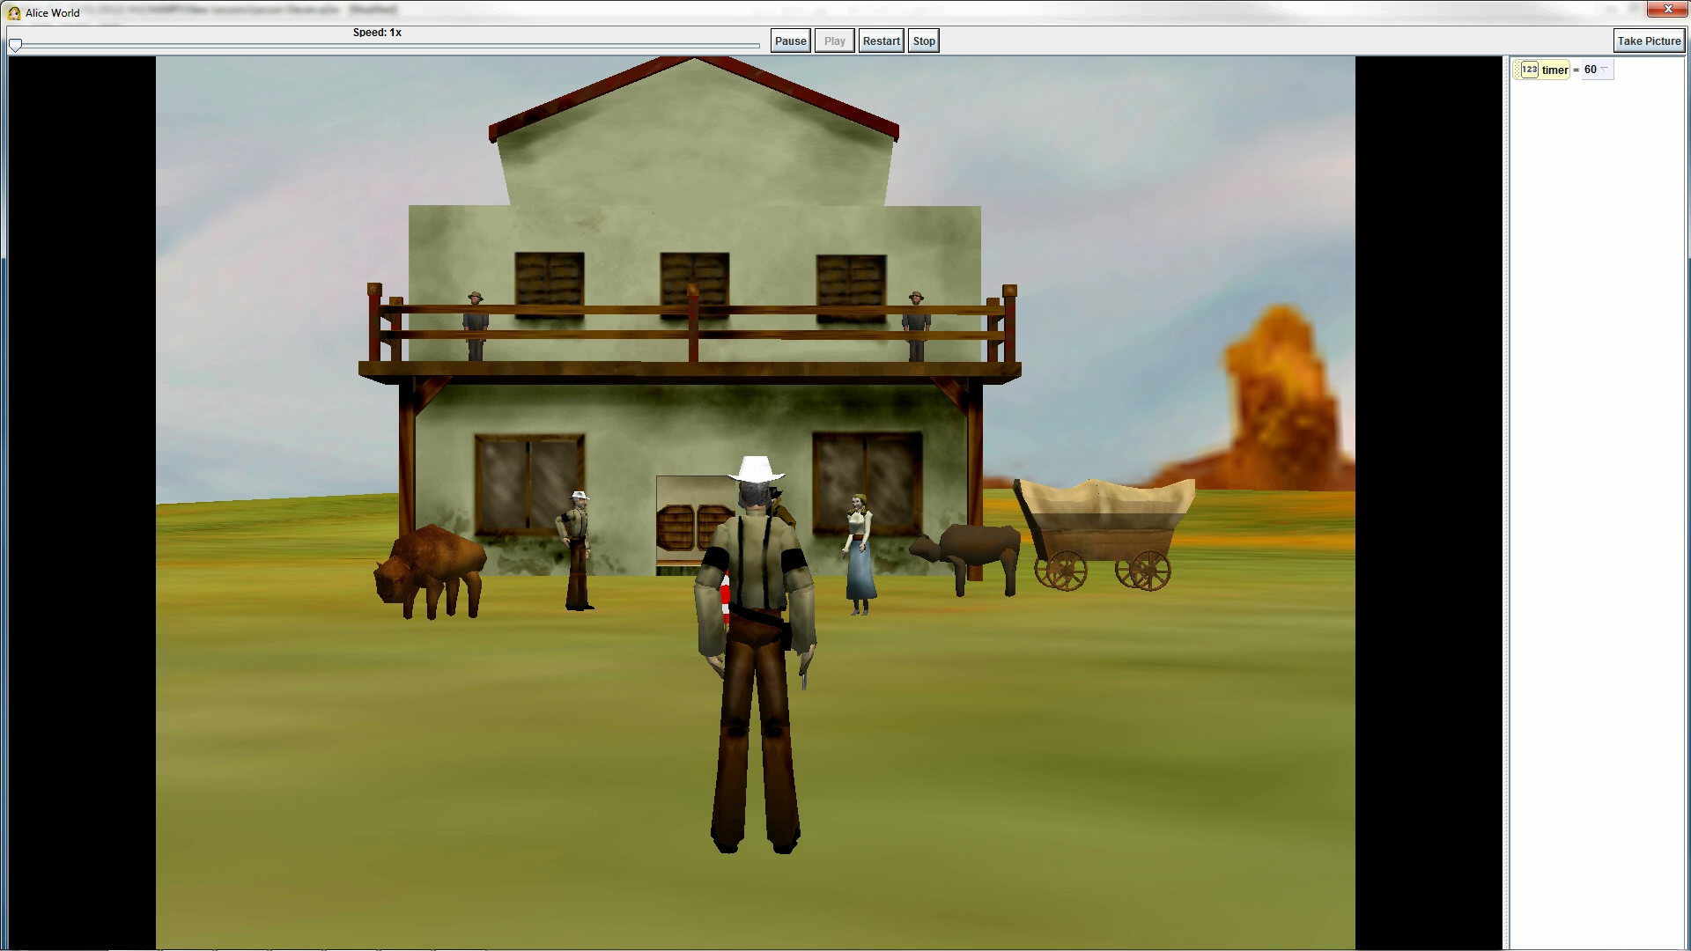
Final Scene
Notes:
The mouse does not show up in the video, but it is still clicking on objects after the timer runs out.

